Slide 1
Title: Matrix Calculator
FIRST REVIEW DATE :24/12/2024
Project Students:
NAME | REGISTER NO | BRANCH | SECTION
Sarvesh S | 240701479 | CSE | H
Sam Devaraja J | 240701463 | CSE | H

Slide 2
Abstract
This project implements a comprehensive Matrix Calculator using the C programming language, designed to perform various operations on 2x2 and 3x3 matrices. The calculator provides functionalities such as determinant calculation, matrix addition, subtraction, multiplication, transposition, and power computation. The program is structured for user interactivity, enabling the selection of specific operations through a menu-driven interface.
Key features include:
Determinant Calculation: Computes the determinant of 2x2 and 3x3 matrices to determine linear independence.
Matrix Addition and Subtraction: Handles element-wise operations for 2x2 or 3x3 matrices.
Matrix Multiplication: Supports multiplication of matrices with compatible dimensions.
Transpose: Calculates the transpose of a 2x2 or 3x3 matrix.
Power of a Matrix: Raises square matrices to a user-specified power using repeated multiplication.
The project showcases modular programming with distinct functions for each operation, emphasizing reusability and clarity. Error handling ensures input validity, guiding users in choosing appropriate matrix dimensions and operations. This calculator serves as a practical example of applying fundamental matrix operations, providing utility for educational purposes and basic computational needs.

Slide 3
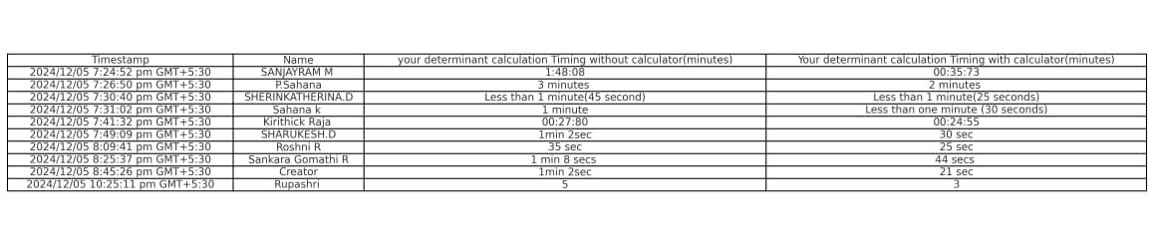
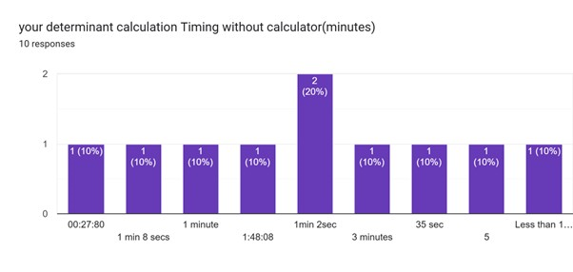
Literature Survey (If any)

Slide 4
Deviation from Existing Application
Customization for Educational Purpose:
While many existing applications like MATLAB or online matrix calculators offer a wide range of advanced functionalities, this project focuses on fundamental matrix operations, specifically tailored for educational use and beginner-level programming practice.
Lightweight Implementation:
Unlike sophisticated software requiring extensive resources, this program is lightweight and can run on any system with basic C compiler support, making it accessible for users with minimal computational power.
Interactive Console-Based Design:
Unlike GUI-based applications, this project employs a command-line interface, providing a straightforward way to learn and understand the core mathematical computations and underlying logic.
No Dependency on External Libraries:
Unlike many applications that rely on pre-built libraries, this project implements all operations from scratch, reinforcing the understanding of algorithms and matrix mathematics.

Slide 5
Modules
int det2x2() - Computes the determinant of a 2x2 matrix using the formula det=a*d−b*c.
Determines whether the matrix is linearly dependent or independent.
int det3x3() - Calculates the determinant of a 3x3 matrix using the cofactor expansion method.
Helps identify the matrix's properties, such as invertibility and dependency.
void matrixAddition() - Performs element-wise addition of two matrices (2x2 or 3x3).
Outputs the resultant matrix after addition.
void matrixSubtraction() - Performs element-wise subtraction of one matrix from another (2x2 or 3x3).
Outputs the resultant matrix after subtraction.
void matrixMultiplication() - Multiplies two matrices of compatible dimensions and computes the resultant matrix.
Supports arbitrary matrix sizes as long as the column count of the first matrix matches the row count of the second.
void transpose() - Computes the transpose of a matrix (2x2 or 3x3) by swapping its rows and columns.
Outputs the transposed matrix.
void power() - Raises a square matrix (2x2 or 3x3) to a user-specified power by repeated multiplication.
Outputs the matrix result after exponentiation.

Slide 6
Deadlines
Sl.No. | Module Name | Target Date
1 | det2x2() | 22.11.2024
2 | det3x3() | 22.11.2024
3 | matrixAddition() | 01.12.2024
4 | matrixSubraction() | 01.12.2024
5 | matrixMultiplication() | 04.12.2024
6 | transpose() | 04.12.2024
7 | power() | 04.12.2024
 | Product Completion | 13.01.2025

Slide 7
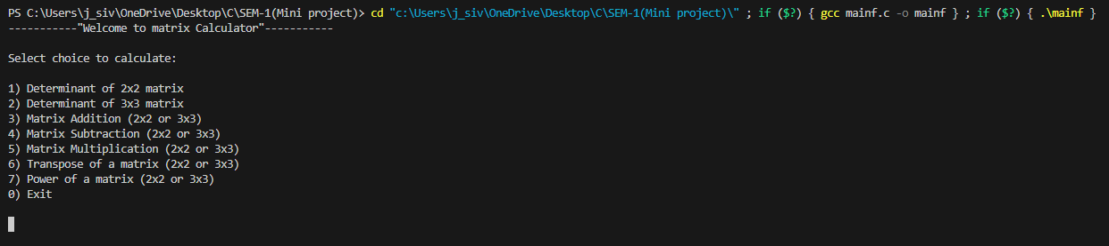
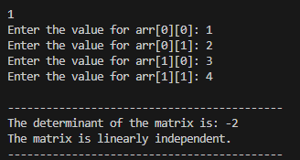
Expected Output

Slide 8
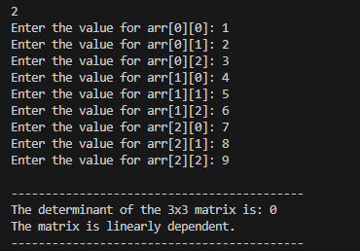
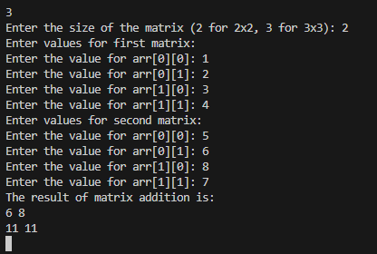

Slide 9
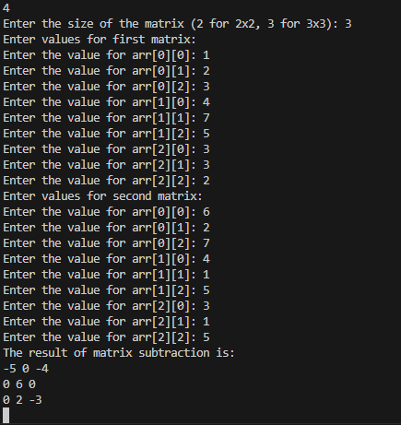

Slide 10
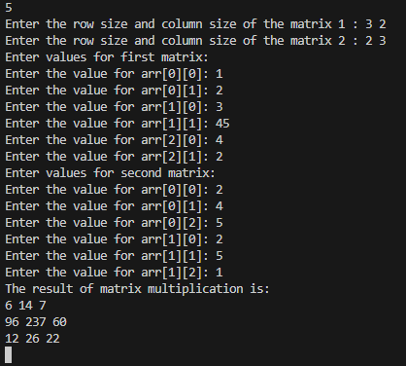

Slide 11
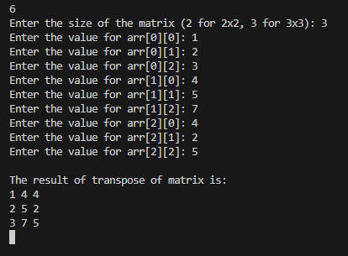
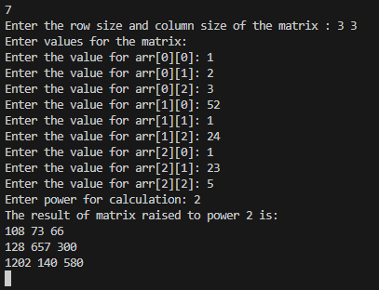

Slide 12


Slide 13
Any Publication targeted
YES / NO

